Slide 1
Accelerometer Controlled Advanced Maze Game Box
Submitted By Project Guide Project Coordinator
-Arun Panwar (Dr.) A. S. Yadav Mrs. Anuradha
-Meghna Goyal Head Of Deptt. Assist. Professor
-Jitendra Sharma E & EE Engg. E & EE Engg.

Slide 2
CONTENT
Introduction.
Equipments Used in the Project.
Features
Algorithms
Simulation on Proteus ISIS.
Game play and Mazes
Helping Sources

Slide 3
INTRODUCTION
The main objective is to reinvent the classic “find-your-way-in-the-maze puzzle”.
The ball for which you have to find the way inside the mazes are controlled by the Accelerometer sensor.
It is a collection of Different type of maze games, which includes simple, complex and Dynamic mazes.
The game is displayed using a 128x64 Graphic LCD.
AVR Studio 4 and winavr is used as IDE and Proteus ISIS is used for simulation.

Slide 4

Equipments Used

Slide 5
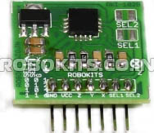
ACCELEROMETER:
ADXL335, 3-axis, +3g and -3g accelerometer is used.
It senses static acceleration of ‘g’ and dynamic acceleration.
It has Five Pin Interface i.e vcc, gnd, x-out, y-out, z-out.
This Accelerometer operates at 3.6 Volt.
Purchased from Robokits.co.in and product code is RKI-1028.

Slide 6
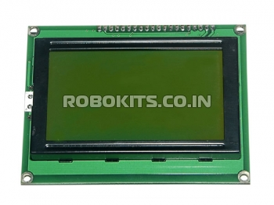
GRAPHIC LCD:
Graphic LCD “LG128643-SMLYH6V” of Dimension 128x64 is used(ETC Electronic).
It uses KS0108B controller(product of Samsung electronics).
This graphic LCD works on 5 Volt Supply.
It has 20 Pin Interface in which there are 8 data pins and LED+, LED-, Vss, Vdd, Vo, D/I, R/W, E, CS1, CS2, RST, Vee pins are available.
Purchased from robokits.co.in.

Slide 7
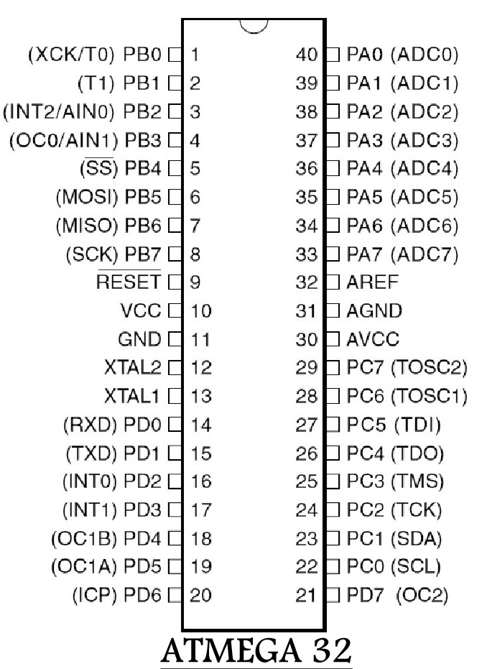
Controller (ATMega 32):
AtMega 32 is a 8 bit product of ATMEL Corp.
It is a 40 pin AVR MCU having 32 kb memory.
It has 4 ports i.e. A, B,C and D.
ADC channels are on the PORT A of this MCU,
so the Accelerometer output pins are at PORT A.
AREF, AVCC and AGND pins are used to set the
reference value, Vcc and GND for ADC.

Slide 8
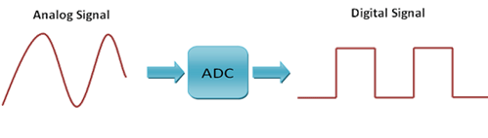
Interfacing of Accelerometer
ADC Channel is mounted on PORT A of the ATMega 32, so the Pins of the accelerometer connected to the PORT A.
Signal Conversion by ADC.
For Single ended conversion
Where Vin: the voltage output of Accelerometer
ADC= (Vin*1024)/Vref

Slide 9
Features of the Games

Slide 10
Features
Level-1,Level-2 and Level-3 with varying complexity and hurdles.
Interactive GUI and Elemental Features like...
A Menu For Selecting Different Channels.
Welcome Screen.
Rebounding Feature for each Level.
Dynamic Elements inside levels.
Score Calculation upto Rank 3.

Slide 11
Play, Pause, Reset, Restart and Power ON/OFF Buttons.
A battery to make game Box Portable.
A complete Industry ready box setup covering all Equipments under one box i.e. accelerometer, PCB circuits wires etc.
A handmade charger to charge battery from AC source.

Slide 12
Game Play and Mazes

Slide 13
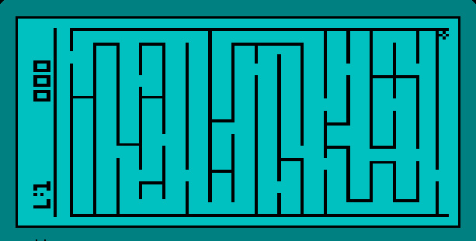
Screenshot of LEVEL-1 Maze, taken from the running Simulation on Proteus ISIS.

Slide 14
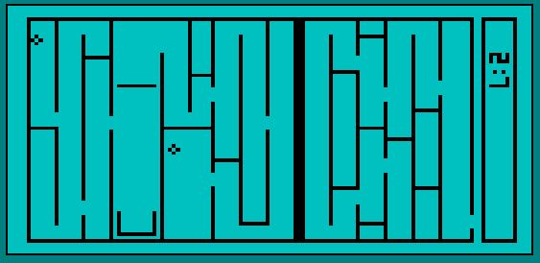
Screenshot of LEVEL-2 Maze, taken from the running Simulation on Proteus ISIS.

Slide 15
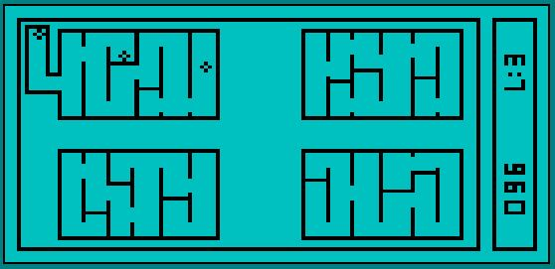
Screenshot of LEVEL-3 Maze, taken from the running Simulation on Proteus ISIS.

Slide 16
Algorithms

Slide 17
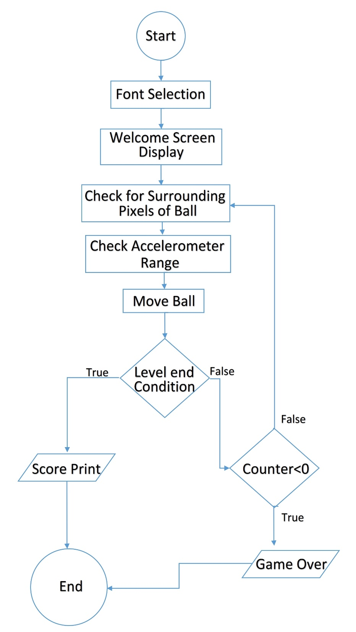
Algorithm of the Maze Game

Slide 18
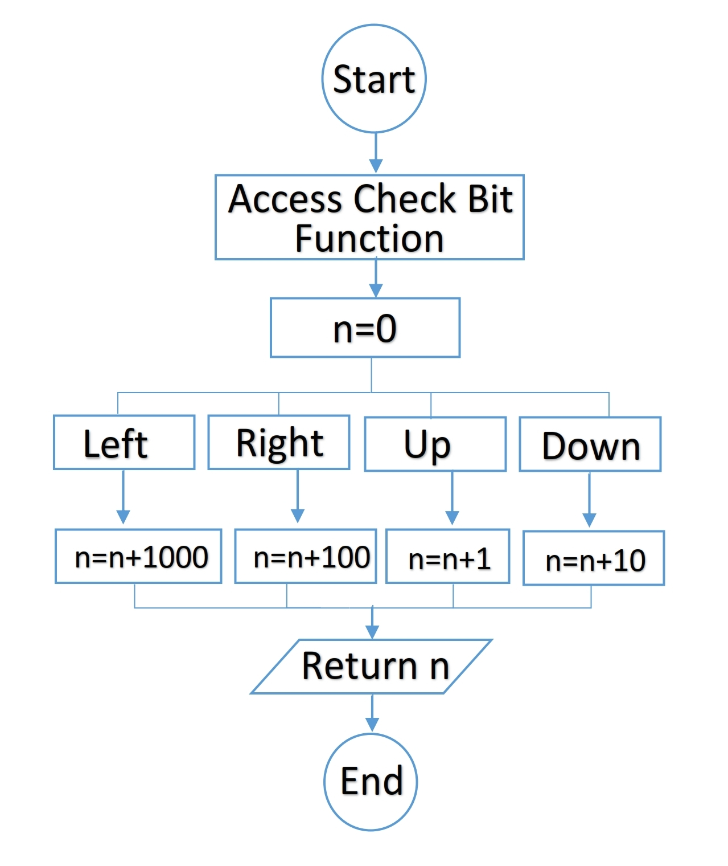
How Surroundings function works
Algorithm of the Maze Game

Slide 19
Simulation

Slide 20
Simulation Using Proteus
Simulation is tested using the VSM technology of software “PROTEUS” and its “ISIS Module”.
ISIS (Intelligent Schematic Input System).
Data Pins connected to PORT D of AtMega 32.
Control Pins connected to PORT C of AtMega 32.

Slide 21
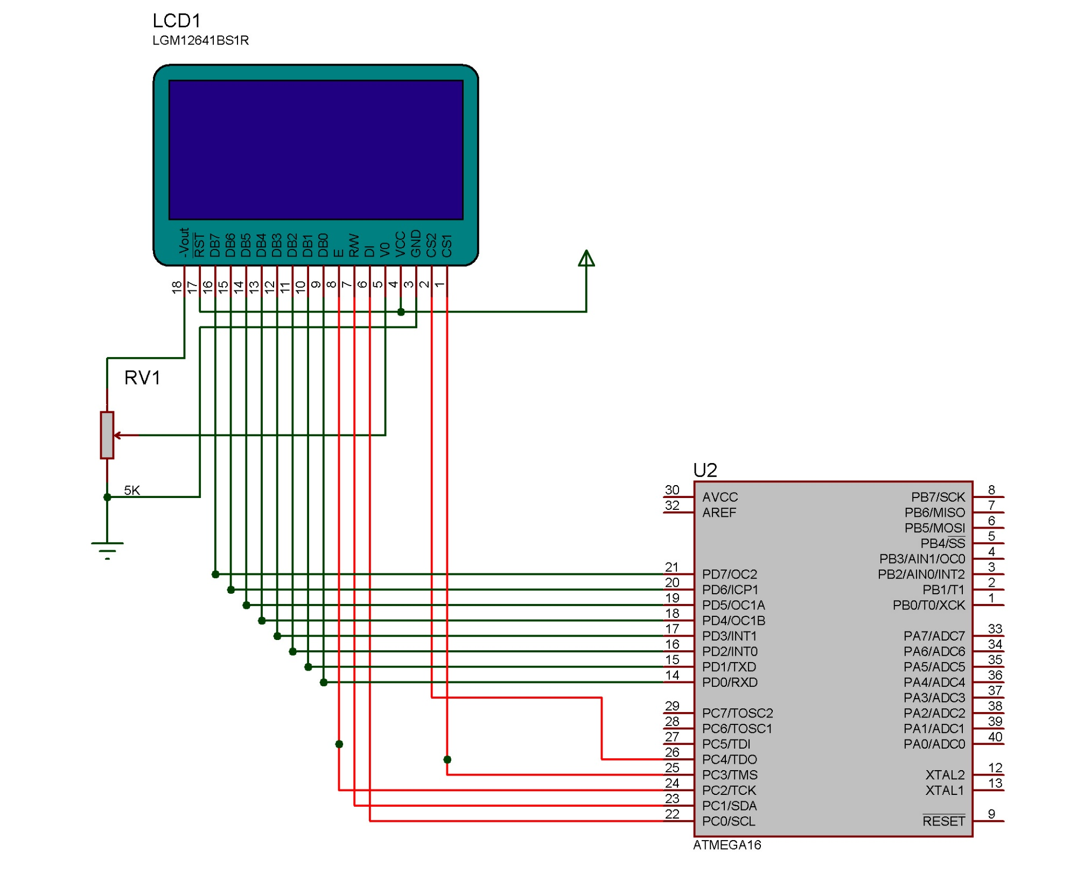
Simulation On Proteus ISIS
A Screen Shot of the Connections Made on Proteus

Slide 22
Helping Sources
Project using the KS0108B controller library of GLCD
and Font Creator Software,
Produced and Written by- F. Maximilian Thiele, me@apetech.de
Library used for testing on 16x2 LCD is
Produced and Written by- Avinash Gupta, eXtremeElectronics.co.in.
AtMega 32 and GLCD datasheets of ATMEL and ETC INC. respectively.
Google, at each and every step of project.

Slide 23
THANK YOU
(Any Questions)

